Slide 1

Physical Lock “Interrogation” Techniques (PLIT)
“We don’t need the key, we will break in”
Brad Welch
Red Team Lead 7/3/2018

Slide 2
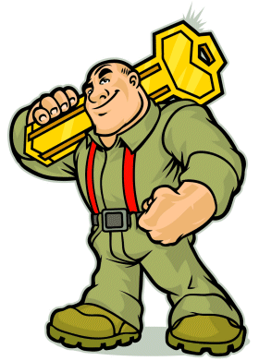
Overview
Pin tumbler lock basics
Physical key standards for PTL
Types of locks to avoid when trying this method
How the attack works, binding and friction
Tools required
Attack
Potential defensive strategies
Questions

Slide 3
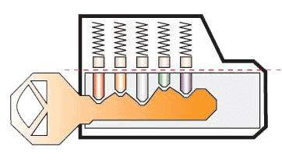
PTL Inner Workings
Springs
Driver pins
Shear line
This is our ‘helper’
Key pins-
Note different lengths
Extremely poor rendition of a key

Slide 4
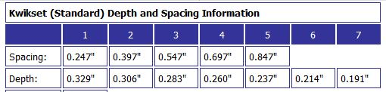
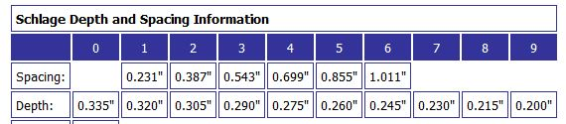
Physical Key Standards
Manufacturers follow well known standards for specifications like:
Key cut depth
Key cut spacing
However, each manufacturer follows a different standard!

Slide 5
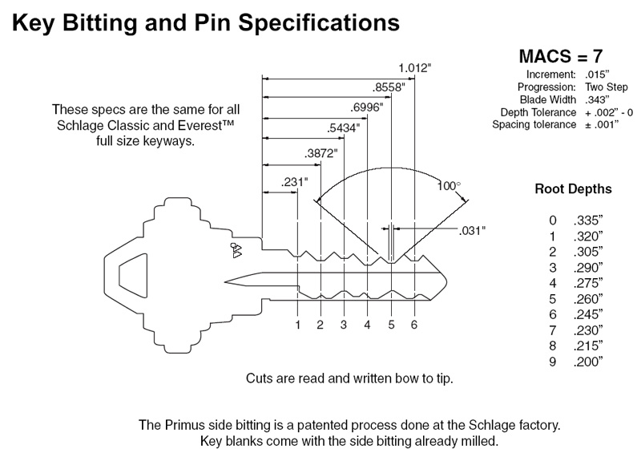
Bitting and Blade Width

Slide 6
Key Profiles
Manufacturers also have different types of profiles or ‘runners’. When leveraging this method of attacking it is critical have the proper blanks with the right profile.
Some blanks are considered not for sale to the general public, well mostly (see Michael’s preso about social engineering). These keys are usually marked “Do Not Duplicate” and are restricted to licensed individuals such as locksmiths, well mostly.
Underground software is available that will identify what manufacturer and tumbler type profile is needed just from a picture of the lock.

Slide 7
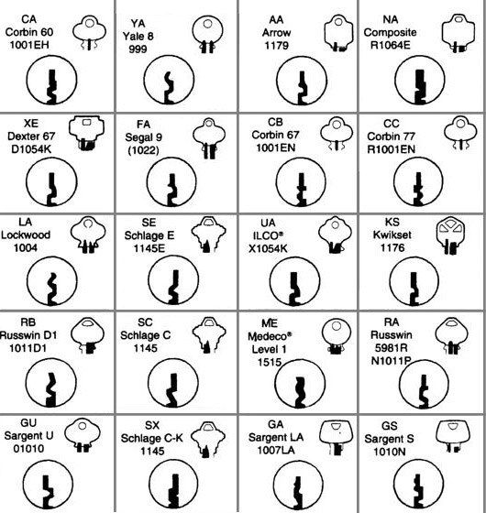
Sample Profiles

Slide 8
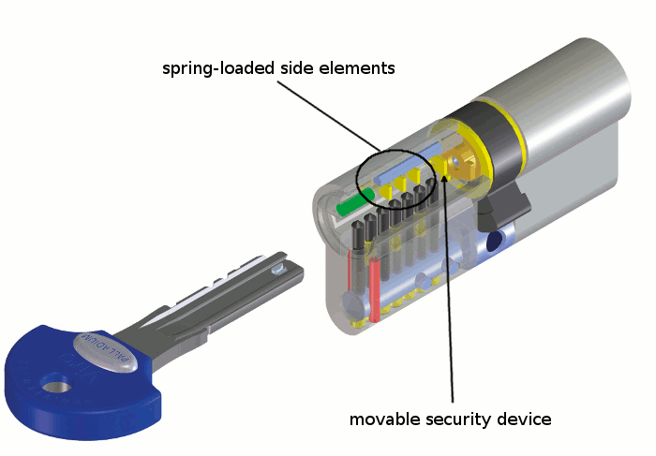
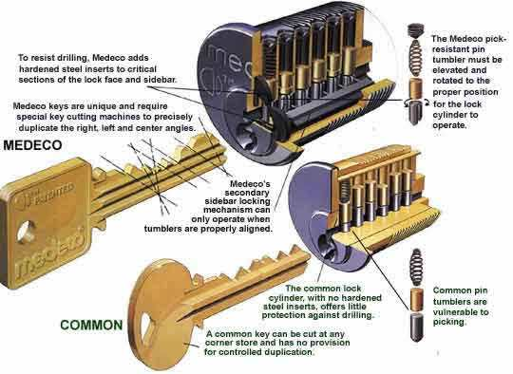
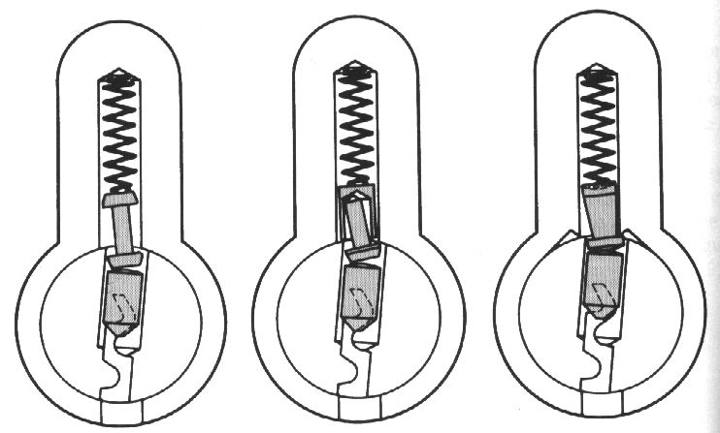
Locks to Avoid
Some locks have anti bind pins or a side bar pin
Dimple pins on the side
Very high security locks (usually you can tell with picks)
Security locks that have break off pins

Slide 9
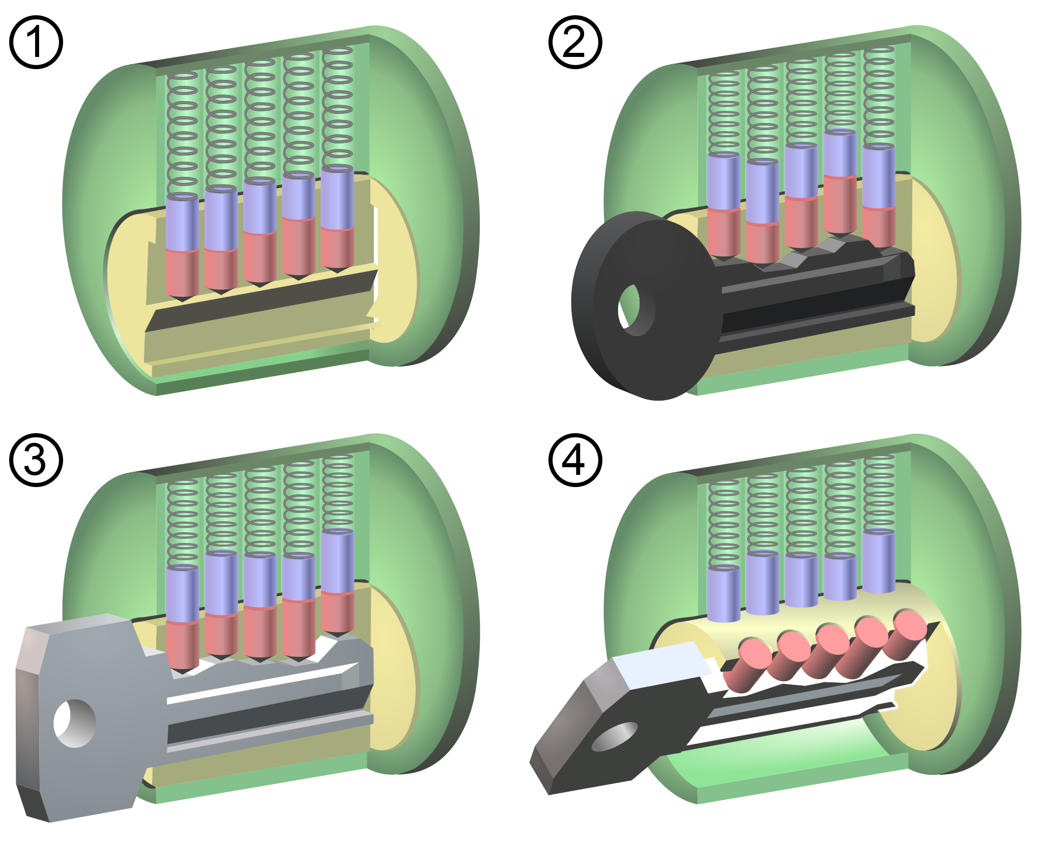
Ready Up- Binding
Pins are not 100% linearly aligned (this is key)
When key pins do not align to shear line, binding occurs
Not all pins will bind at the same time due to imperfections in the manufacturing process
A blank key will push all pins as high as possible
Usually at least two pins will bind

Slide 10

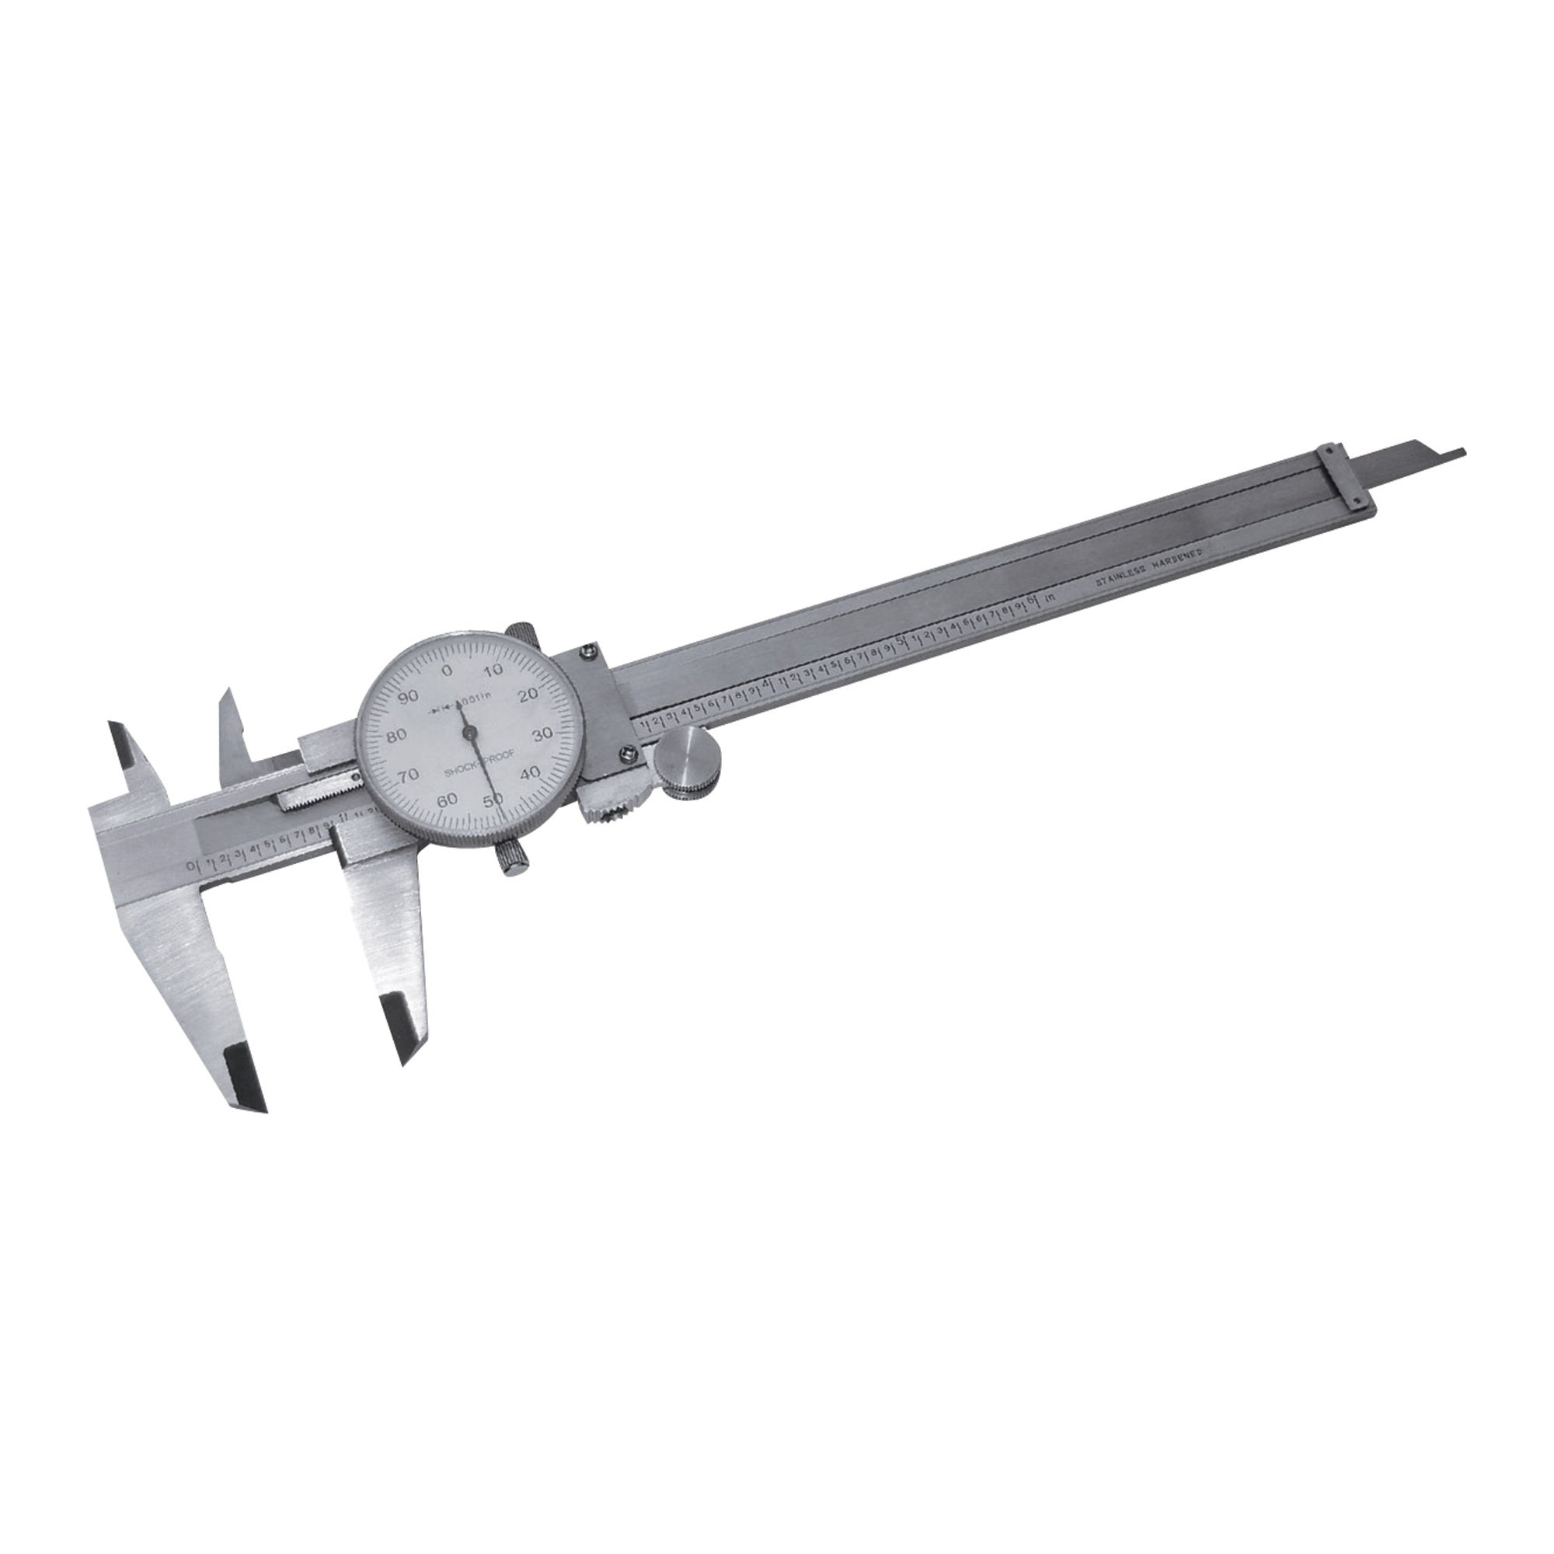
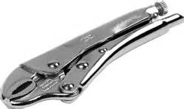
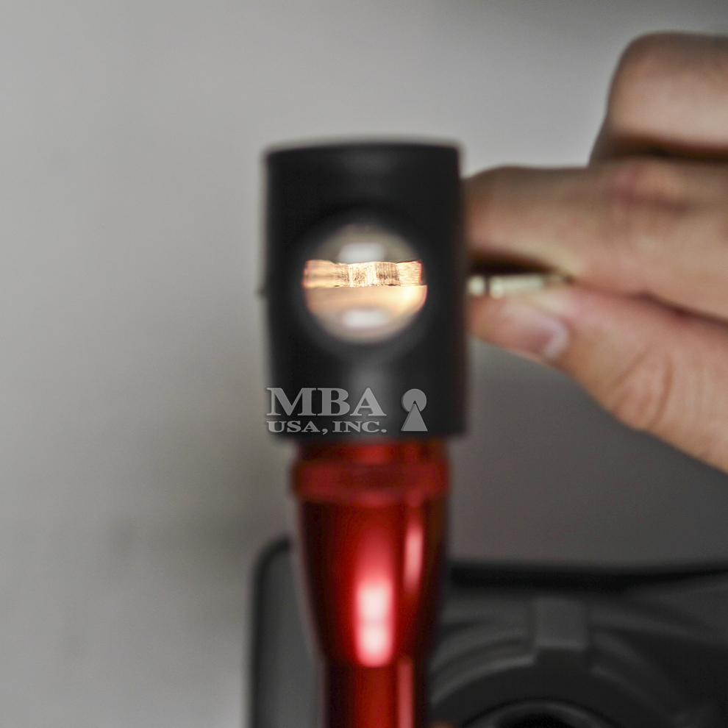
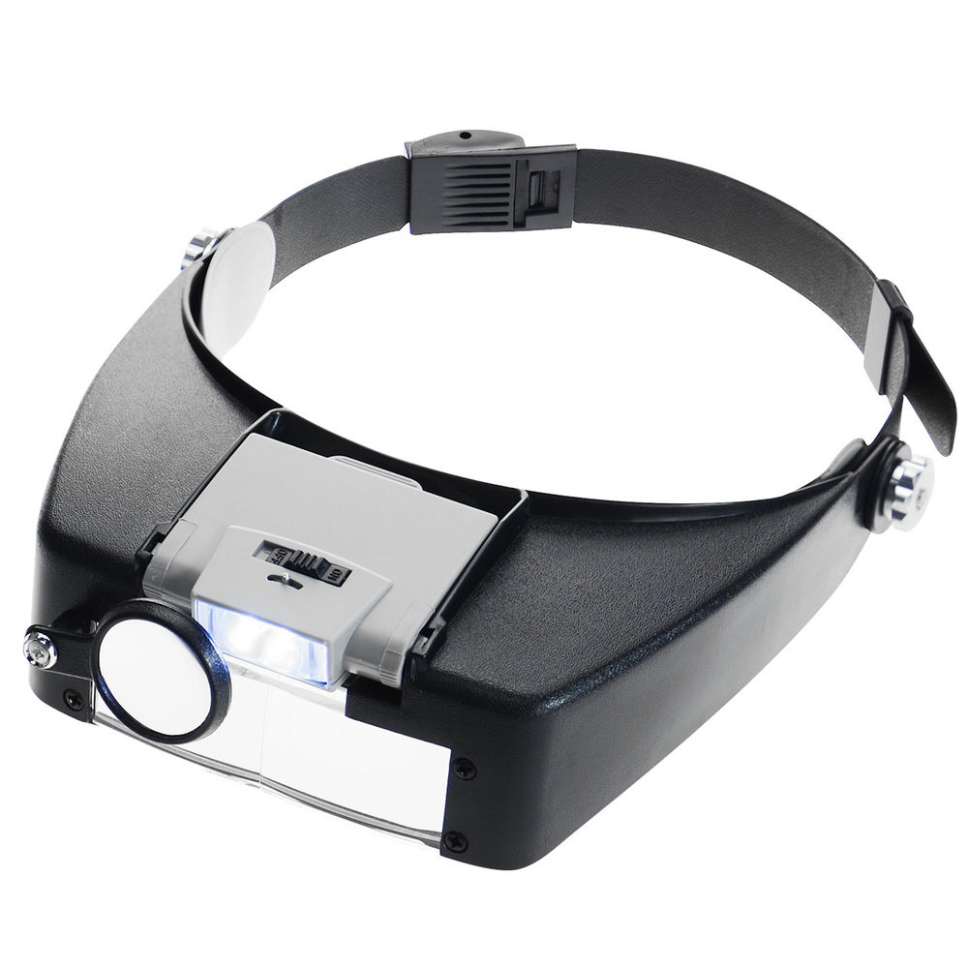
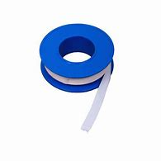

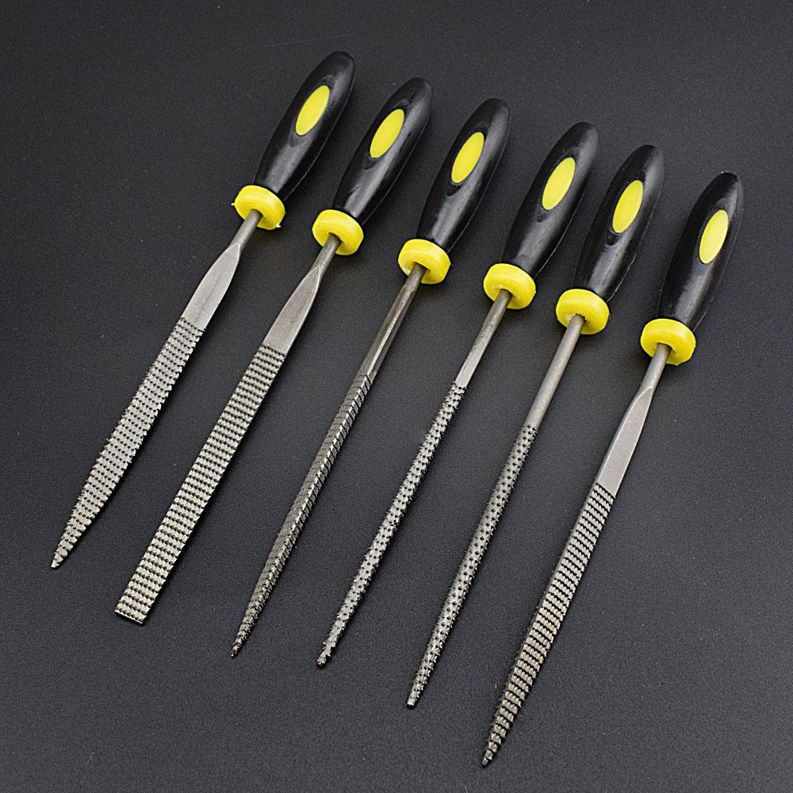
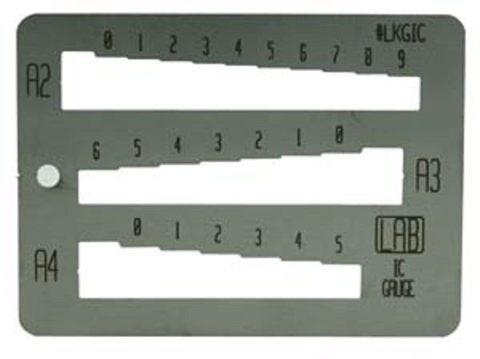
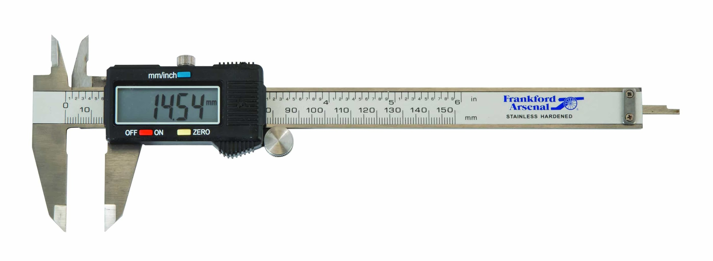
Tools

Slide 11
Initiating Interrogation
Apply secret to blank key
Insert key, turn until it binds then aggressively wiggle
Bound pins will scratch a mark on key
Remove key, look for marks where binding occurred
They will be small but visible
Using key depth data, file down to the first position
It helps to mark spacing on the side
Apply secret and repeat

Slide 12
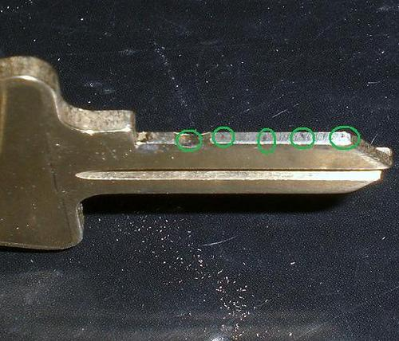
Information Disclosure!
The pins will indicate where there is binding by making small marks

Slide 13

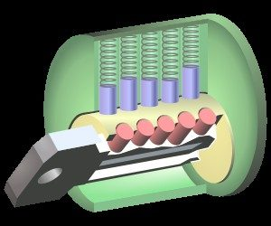
Game Over Player 1
When all key pins are at the shear line, lock opens.

Slide 14
Real World Attack
“Acquired” 10 XX Schlage (do not duplicate) blank keys
Worked in a stairwell with no traffic, no cameras and away from the patrol route
Broke 3 blanks and had several stuck (bad feeling right Jason)
Several hours of filing
Once key was complete, recorded the depth of each cut
Example depth code 314572 will allow you to recreate the key

Slide 15
Defensive Strategies
Purchase higher security locks/tumblers
Define physical security zones and key differently
Do not use common keying between different facilities
Increase roaming guard coverage
There are no effective defensive controls that are cheap
Pay attention to short chunky bald guys carrying files

Slide 16
Tips
Get AUTHORIZATION
Use thin latex or nitrile gloves (paint/marker + shavings = bad day)
Always use the right profile blank - buy 10 or 20
Head mounted light and jeweler mask with variable power helps
Cheap hobby files work well, triangle files are the best
Live interrogation should be done in low traffic areas & no cameras
Take your time

Slide 17
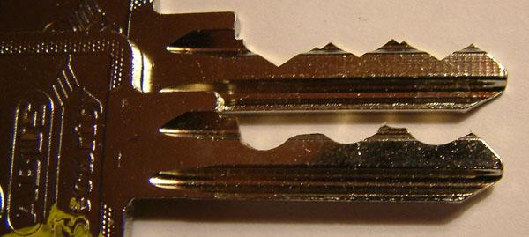
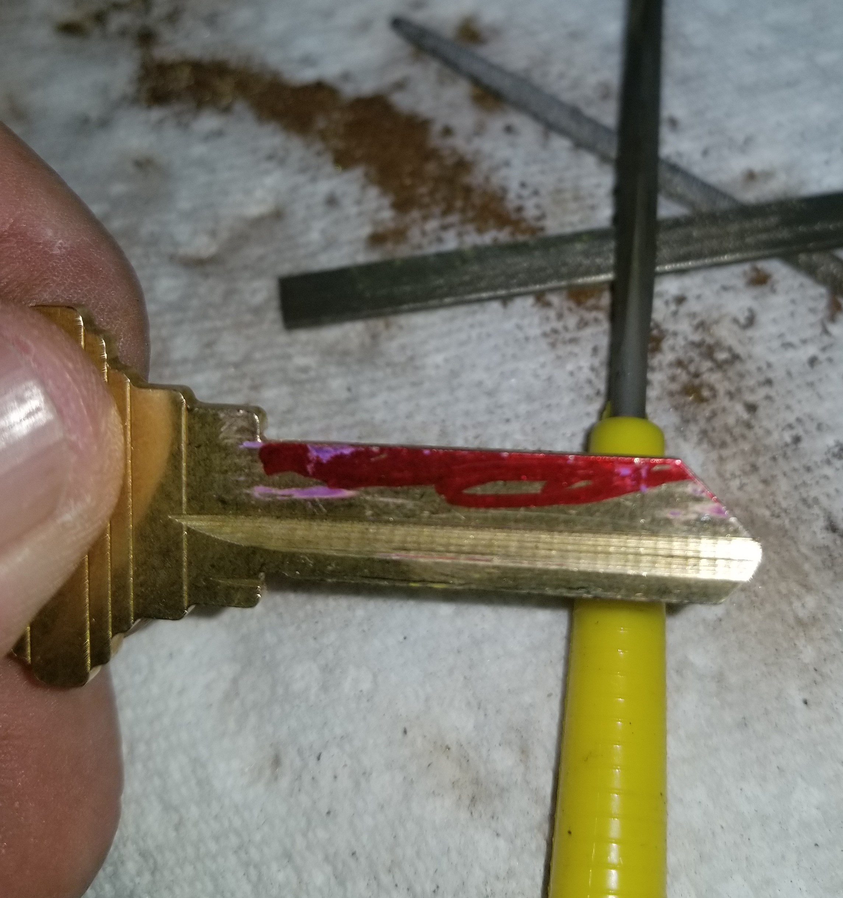
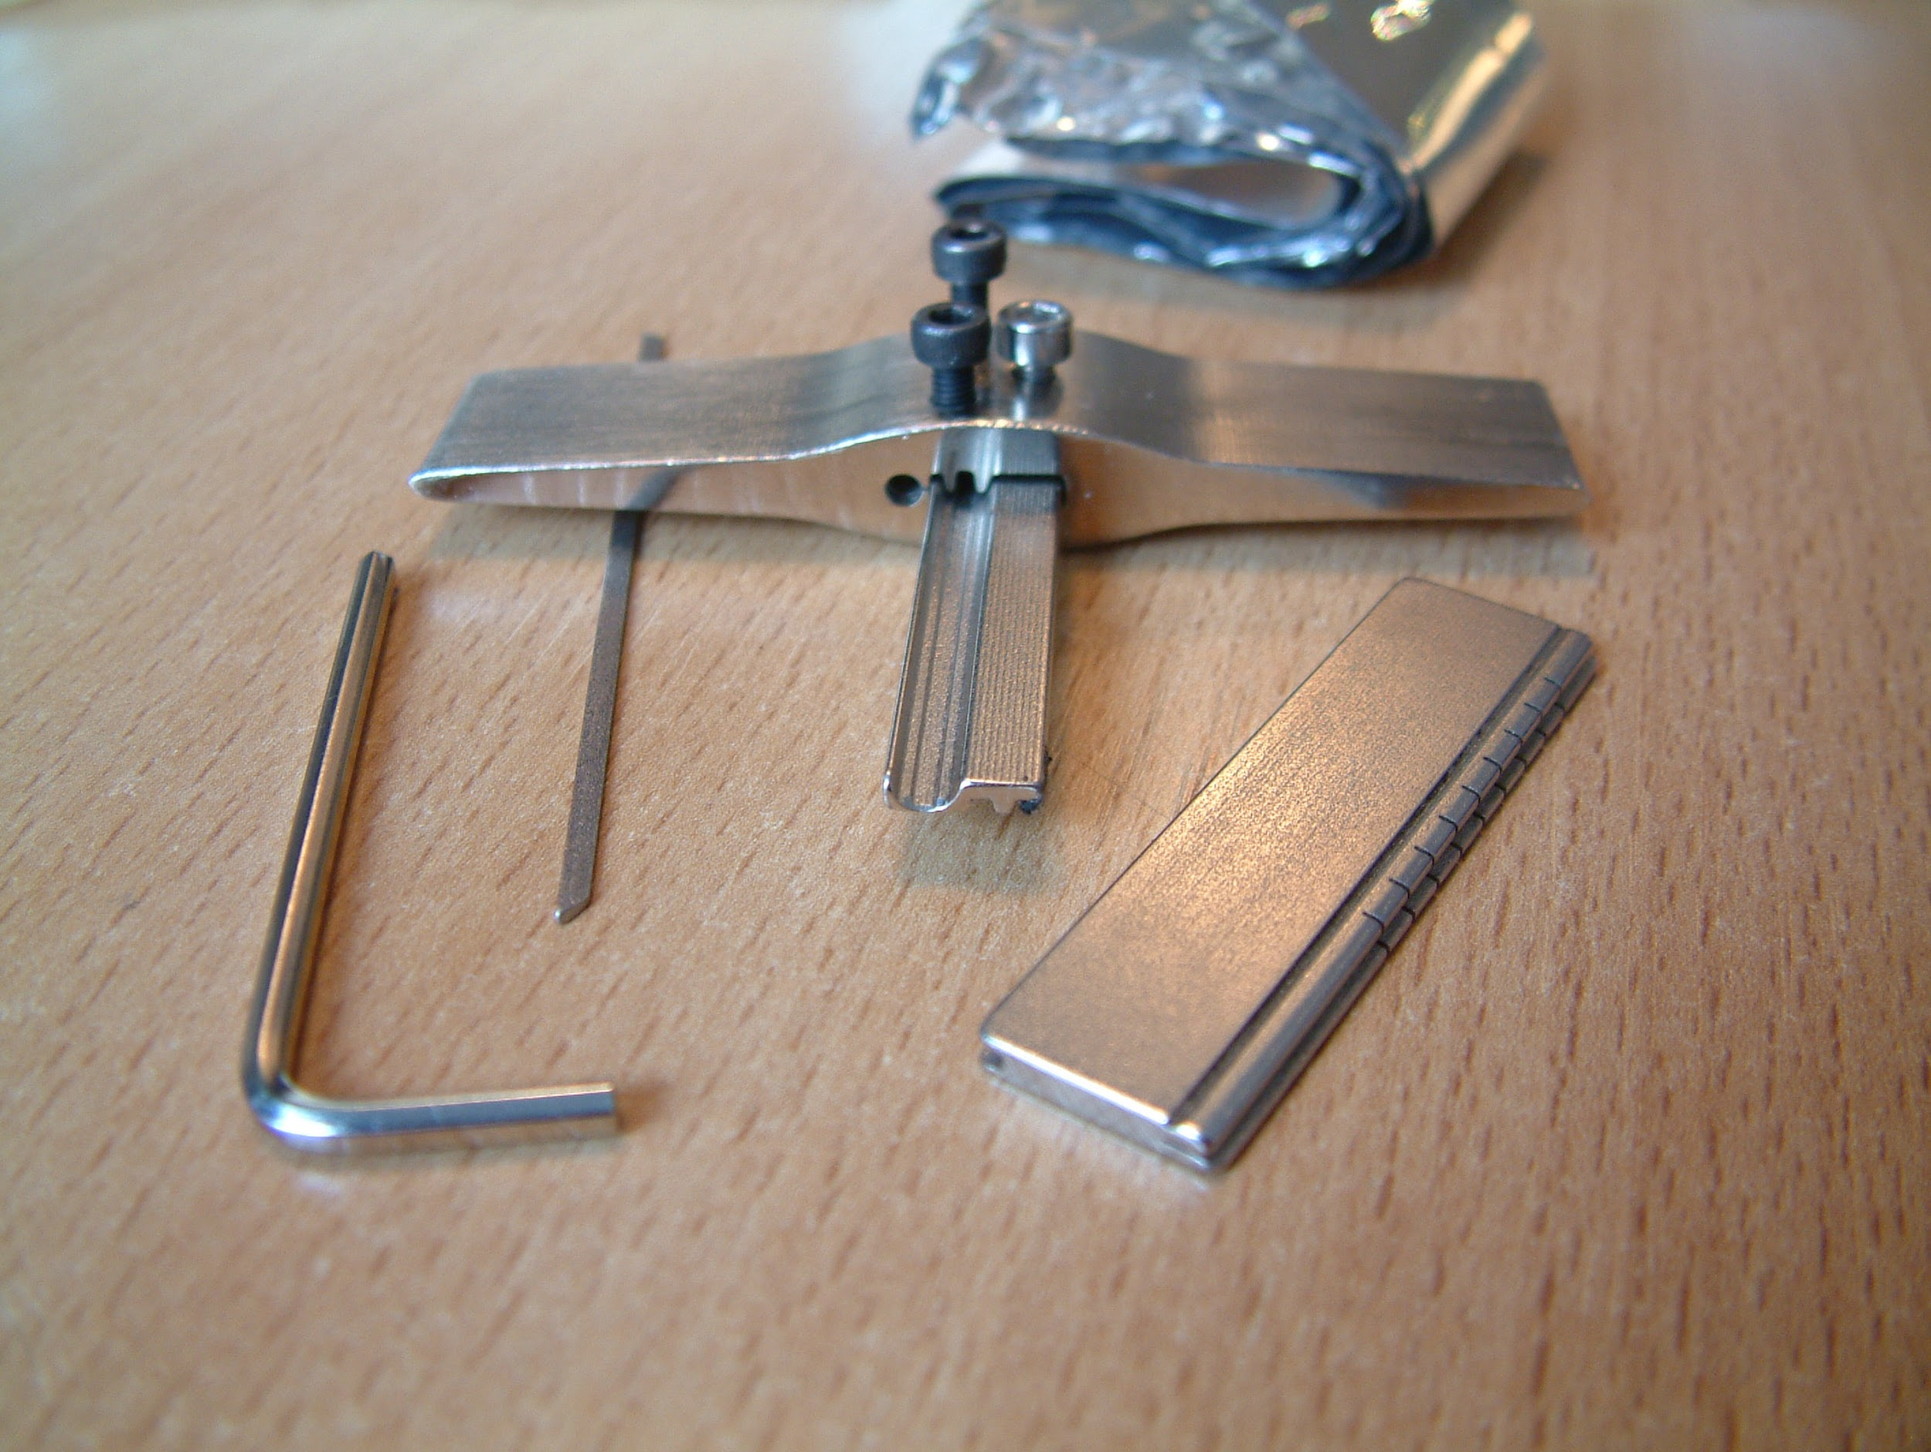

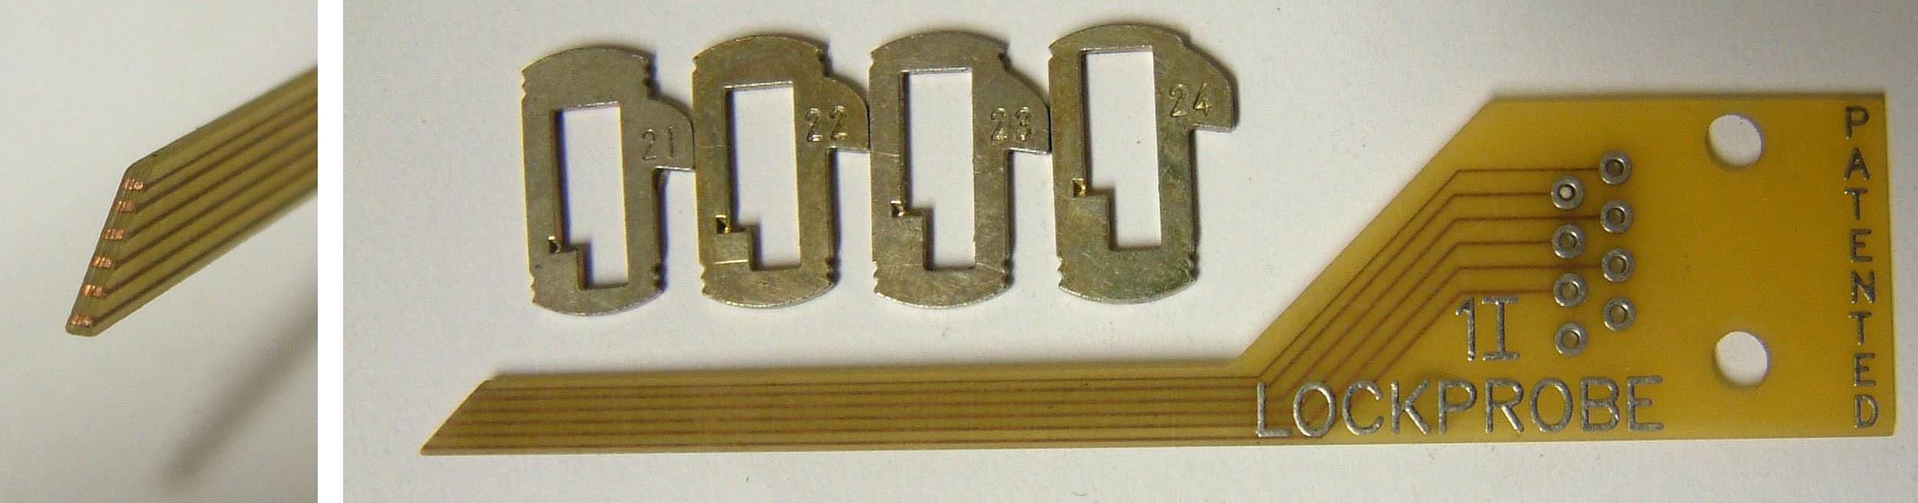
Random Images

Slide 18


